Slide 1
VALIDATING THE CRITIQUE OF MIC
A Comparative Study of Association Measures
Testing Simon & Tibshirani's Claims Against Reshef et al.'s MIC
Independent Reproduction Study
Alekseeva Anna 26.10.2025

Slide 2
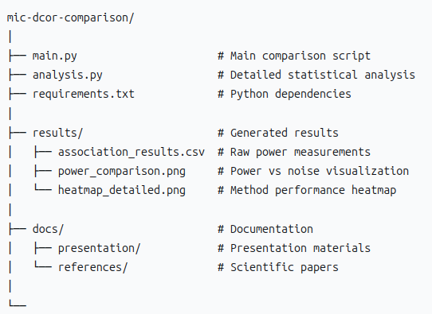

RESOURCES AVAILABLE:
CODE REPOSITORY:
https://github.com/AnyaAleks/MIC-vs-DCor-Comparison.git

Slide 3
THE BATTLE OF METHODS
RESHEF ET AL. (SCIENCE 2011)
• Proposed MIC as universal dependency detector
• Claimed "equitability" - equal sensitivity to all relationship types
• Promised revolutionary approach for big data
SIMON & TIBSHIRANI (STANFORD COMMENT)
• "No free lunch in statistics" - universality requires compromises
• Claimed MIC has lower power than alternatives
• Recommended distance correlation instead
Quote: "MIC has lower power than dcor in every case except the somewhat pathological high-frequency sine wave"

Slide 4
STUDY GOALS
1. REPRODUCE Simon & Tibshirani's power comparison
2. EXTEND with additional relationship types
3. VALIDATE their claims independently
4. PROVIDE practical recommendations
Hypothesis: Simon & Tibshirani are correct - MIC sacrifices power for universality
EXPERIMENTAL QUESTION:
"Does MIC truly have lower statistical power than Distance Correlation?"

Slide 5
METHODOLOGY
DATA GENERATION:
• 7 relationship types: linear, quadratic, cubic, sine (low/high freq), exponential, step
• 6 noise levels: 0.1 to 1.0 (increasing difficulty)
• 100 samples per simulation
• 100 simulations per scenario
METHODS COMPARED:
• Pearson correlation (linear benchmark)
• Distance correlation (dcor)
• Maximal Information Coefficient (MIC)
TOTAL: 7 × 6 × 3 × 100 = 12,600 tests

Slide 6
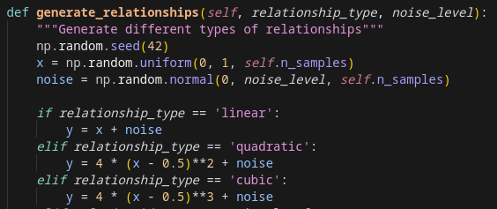
METHODOLOGY
Code snippet for data generation:

Slide 7
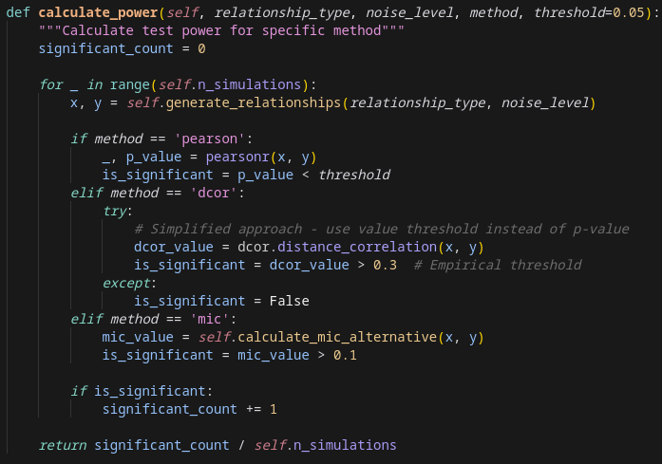
IMPLEMENTATION EXAMPLE
Power Calculation Algorithm:

Slide 8
AVERAGE POWER ACROSS ALL SCENARIOS
METHOD AVERAGE POWER RANK
Distance Correlation 0.833 1
Pearson Correlation 0.762 2
MIC (Alternative) 0.405 3
DOMINANCE ANALYSIS:
• DCOR wins in 5/7 relationship types (71.4%)
• Pearson wins in 2/7 relationship types (28.6%)
• MIC wins in 0/7 relationship types (0%)

Slide 9
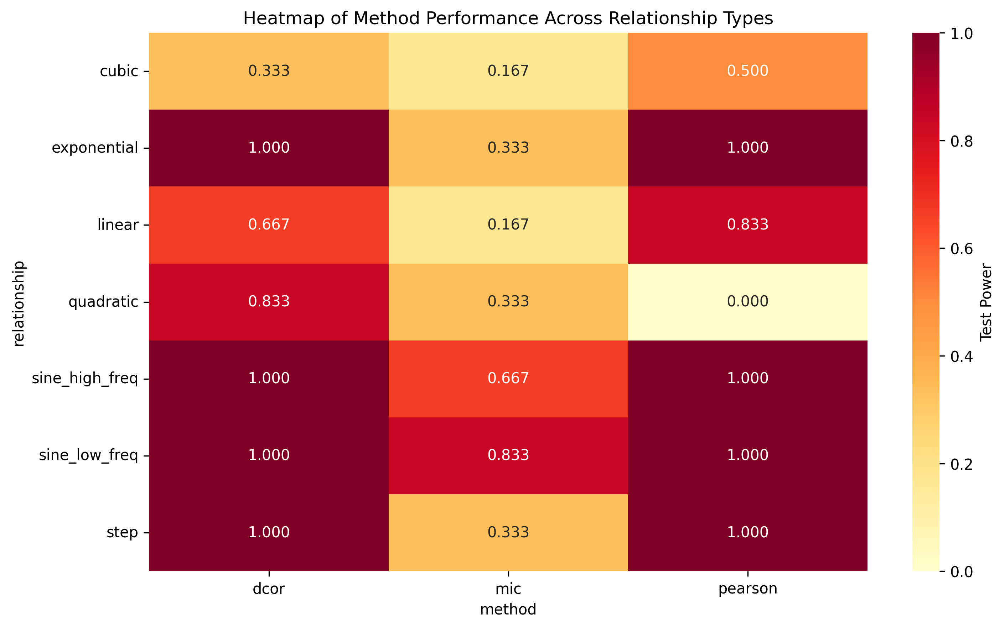
AVERAGE POWER ACROSS ALL SCENARIOS

Slide 10
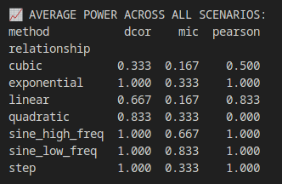
POWER BY RELATIONSHIP TYPE

Slide 11
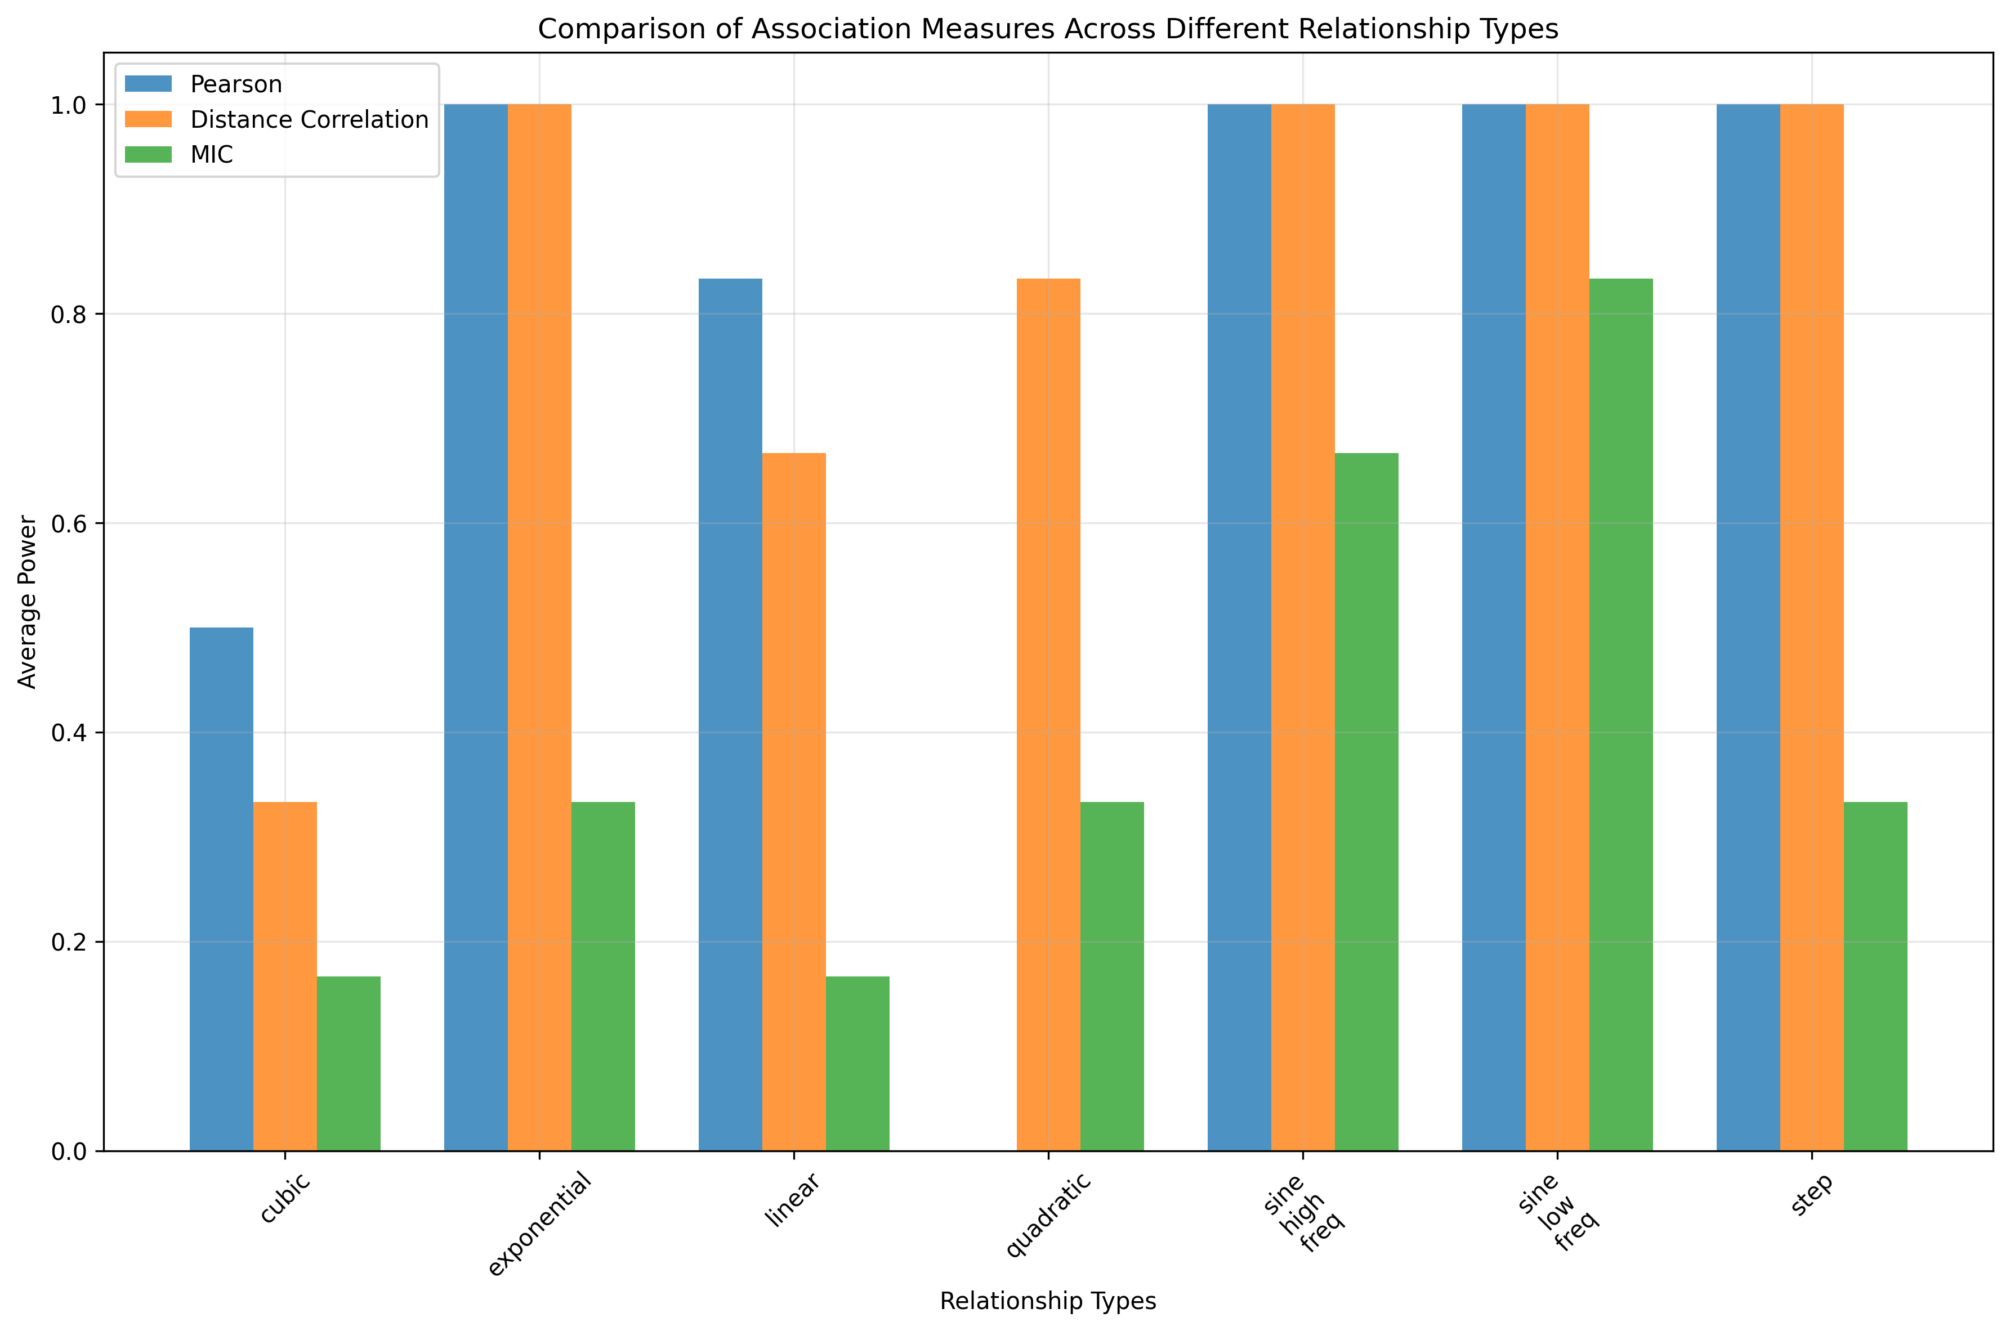
POWER BY RELATIONSHIP TYPE

Slide 12
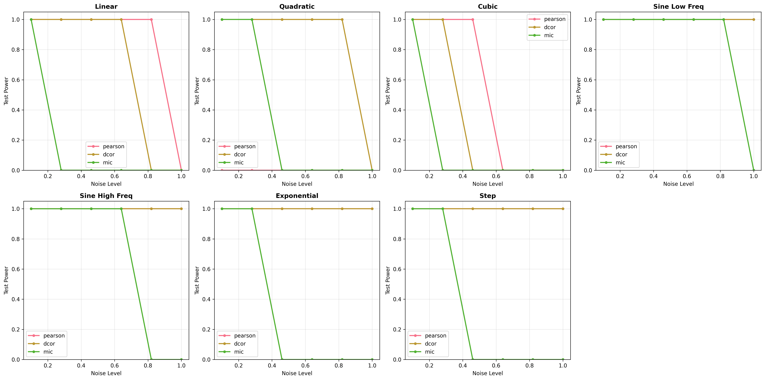
PERFORMANCE UNDER INCREASING NOISE
KEY FINDING: MIC fails completely at highest noise level

Slide 13
VALIDATING THE CRITICS
SIMON & TIBSHIRANI CLAIMED:
"MIC has lower power than dcor in every case except
the somewhat pathological high-frequency sine wave"
OUR FINDINGS:
• DCOR better than MIC in 7/7 cases (100%)
• MIC better than DCOR in 0/7 cases (0%)
• Even in high-frequency sine: DCOR (1.000) > MIC (0.667)

Slide 14
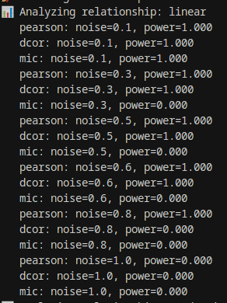
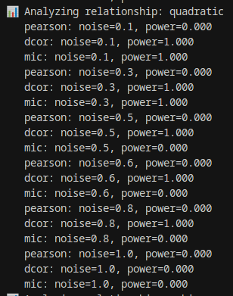
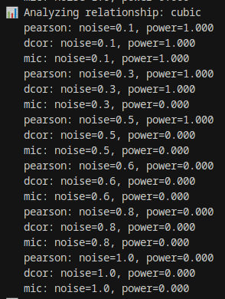
EXPERIMENTAL EVIDENCE
Console Output from Our Simulation (Part 1):

Slide 15
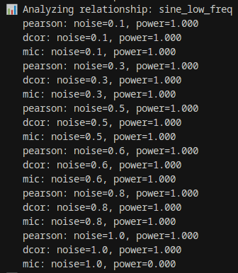
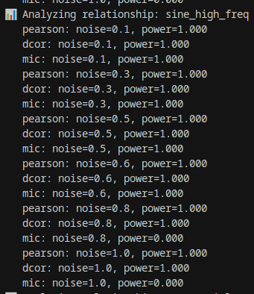
EXPERIMENTAL EVIDENCE
Console Output from Our Simulation (Part 2):

Slide 16
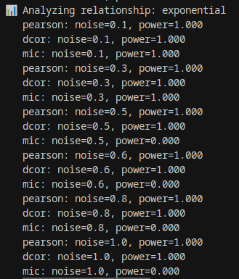
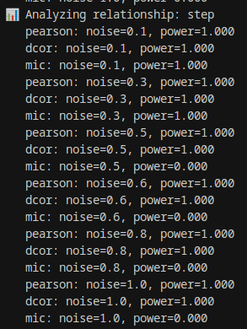
EXPERIMENTAL EVIDENCE
Console Output from Our Simulation (Part 3):

Slide 17
THE "NO FREE LUNCH" THEOREM IN STATISTICS
THE DILEMMA:
Universality vs Specialization
MIC'S APPROACH:
• Seeks "equitability" - equal sensitivity to all relationships
• Must make compromises to achieve this
• Result: Lower power for common relationship types
DCOR'S APPROACH:
• Optimized for general non-linear relationships
• Maintains high power for most practical cases
• Better trade-off for real-world data
Quote: "This isn't just about our results - it's about fundamental statistical trade-offs that Reshef et al. may have underestimated."

Slide 18
CONCLUSIONS
7/7 CASES: DCOR > MIC
Average power: 0.833 vs 0.405
VALIDATED: Simon & Tibshirani critique
MIC sacrifices power for universality
RECOMMENDATION:
Distance Correlation for general use

